Slide 1
ESL Cloud System (Azure DevOps CI/CD)
Cloud Team
2020.03.12

Slide 2
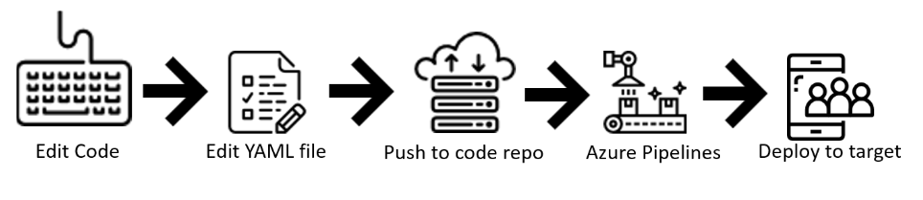
Azure Devops CI/CD
Project Source code Repository with 'Dockerfile' (Bitbucket repo)
Azure Container Registries (Private repo for Dockerized container image)
Create AKS cluster (Kubernetes Service)
Create Devops Organization
Create project
Create pipeline for a specific project and map (source repo, Azure Container Registry, Image name, Service port)
It automatically creates ‘azure-pipelines.yml’ file with all Pipeline step’s configurations mentioned in it.
In addition to above step we must create ‘deployment.yml’, ‘service.yml’ and ‘Dockerfile’ files.
azure-pipelines.yml - Describes build stage, jobs, steps, tasks, etc.
deployment.yml - Describes how many kubertnetes pods, actions if some pods fails, blah blah
service.yml - Provides network access to pods from outside.
Dockerfile - Pipeline uses this Docker spec file during container image creation.
If there is any new commits to source repo, pipeline will build project, push container image to ACR and finally
deploys container image from ACR to AKS.

Slide 3
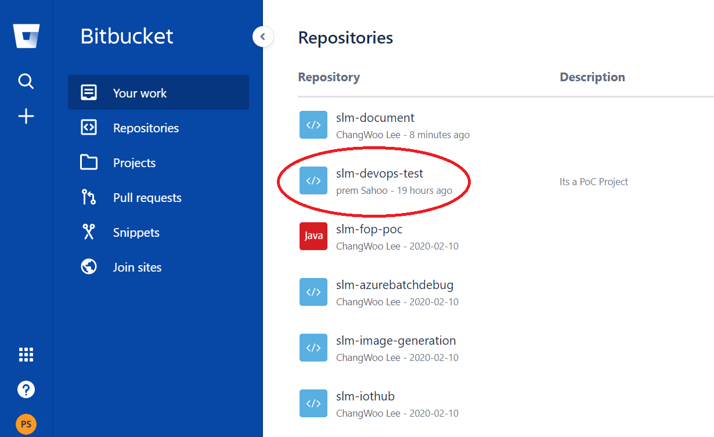
Azure DevOps CI/CD
Project Source code repository (github or Bitbucket or Azure repo)
We are using Bitbucket repo.

Slide 4
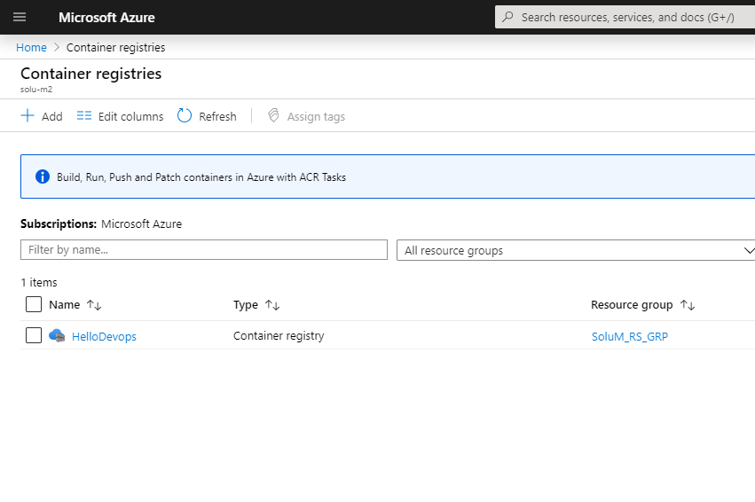
Azure DevOps CI/CD
ACR - Azure Container Registries (Private repository for dockerized container image for user’s application)
We need to create a new container registries in Azure portal Dashboard.

Slide 5
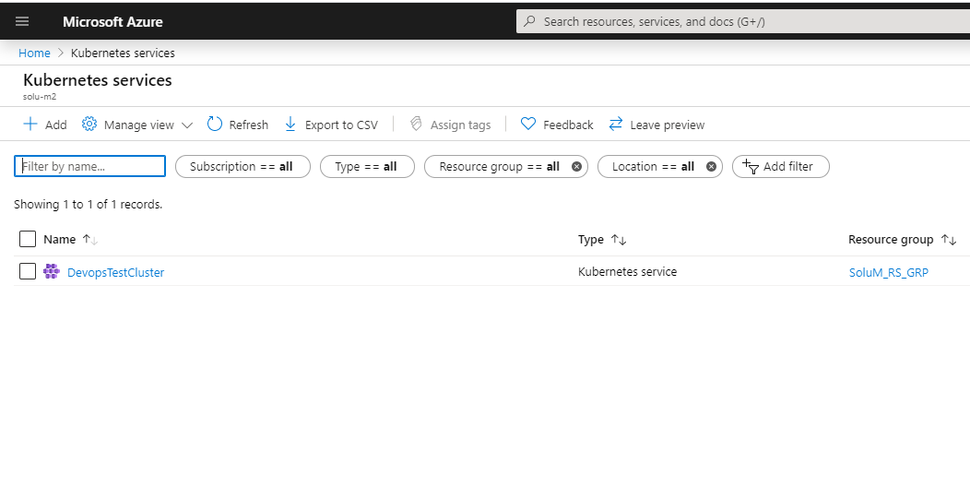
Azure DevOps CI/CD
AKS - Azure Kubernetes Service (Creates a AKS cluster and nodes, where dockerized container images will be deployed)
We need to create a new Kubernetes services in Azure portal Dashboard.

Slide 6
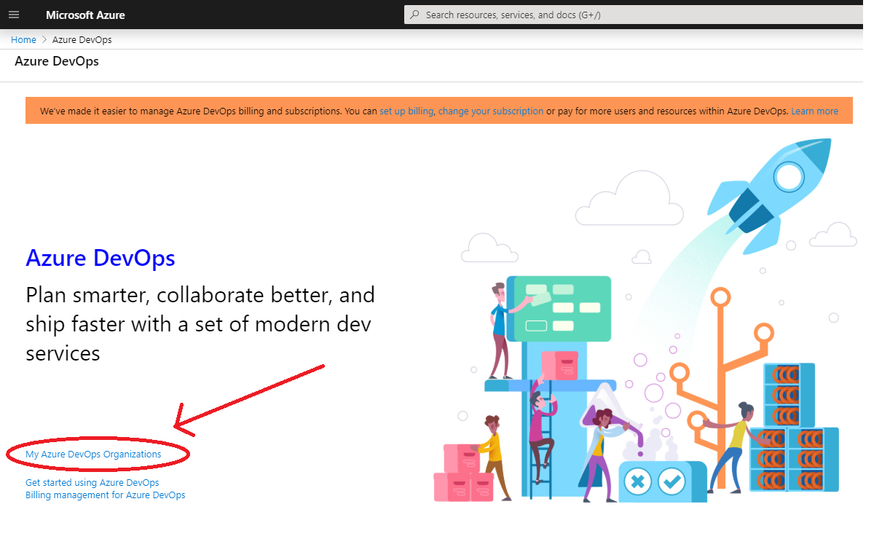
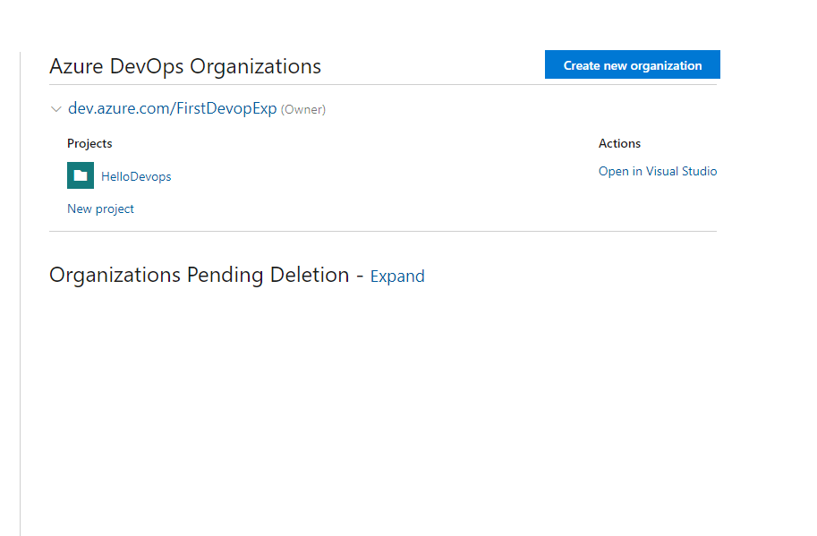
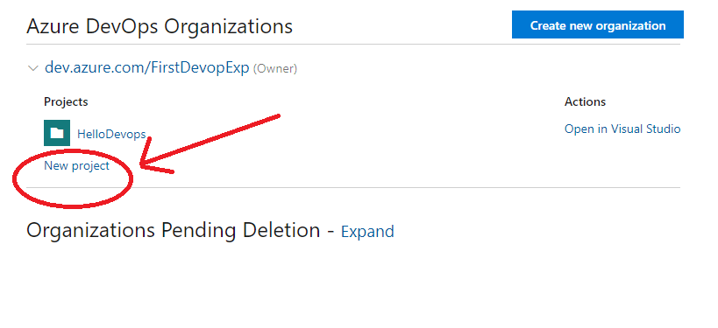
Azure DevOps CI/CD
Go to DevOps in Azure portal.
Click on ‘My Azure DevOps Organisation’
Click on ‘Create new organisation’ and ‘New project’

Slide 7
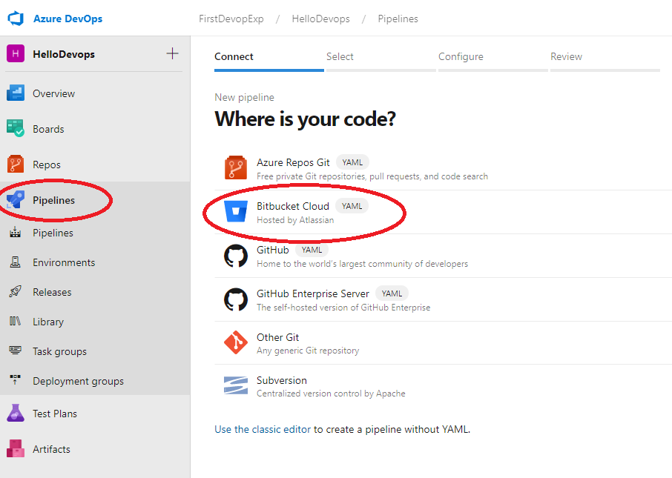
Azure DevOps CI/CD
In DevOps dashboard, create a Pipeline for the newly created project.
Choose the project source code repo as shown below.
Select the specific project from Bitbucket repo.

Slide 8
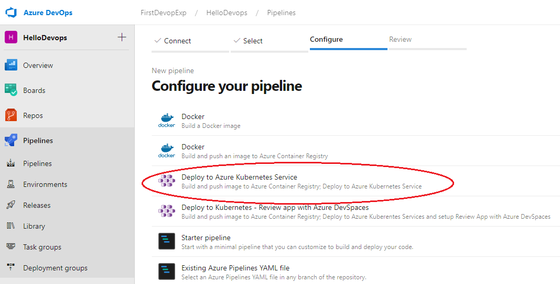
Azure DevOps CI/CD
Configure Pipeline with option ‘Deploy to Azure Kubernetes Service’ as shown below.

Slide 9
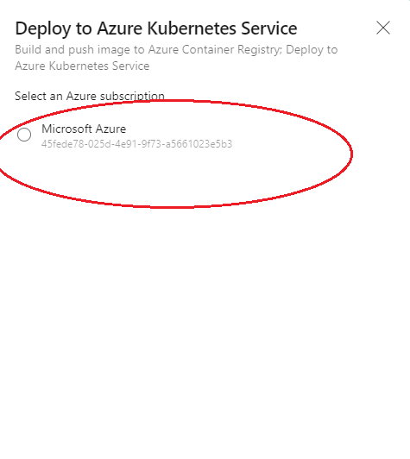
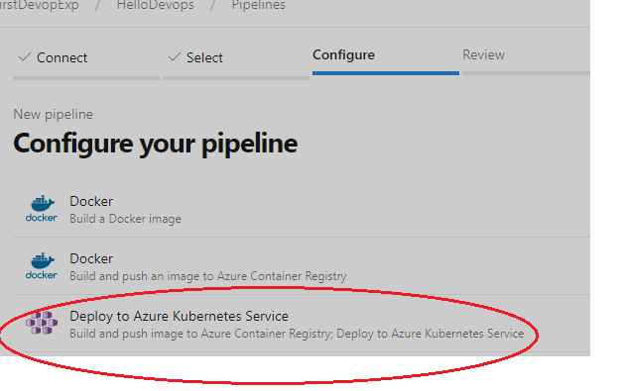
Azure DevOps CI/CD
Configure Pipeline with option ‘Deploy to Azure Kubernetes Service’ as shown below.
Select Microsoft Azure radio button.

Slide 10
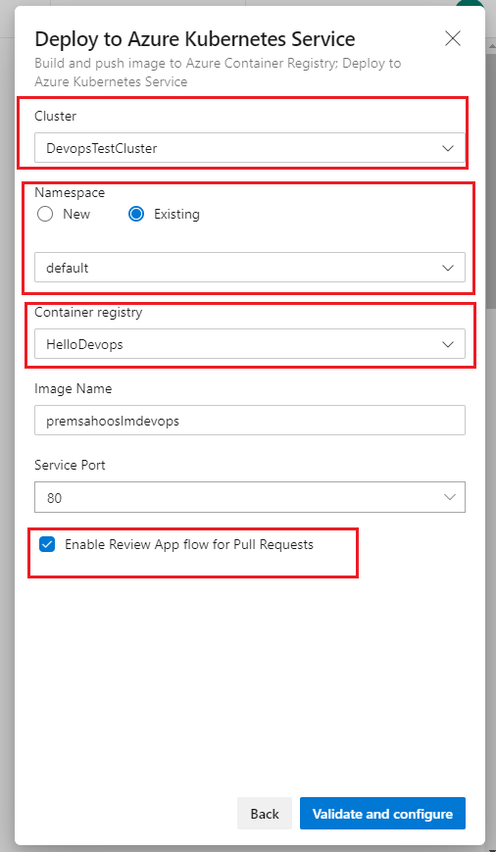
Azure DevOps CI/CD
Select previously created AKS Cluster
Select ‘Existing’ namespace with ‘default’ option
Select previously created Container registry
Enter any ‘Image Name’ and ‘Service Port’
Check ‘Enable Review App flow for Pull Requests’

Slide 11
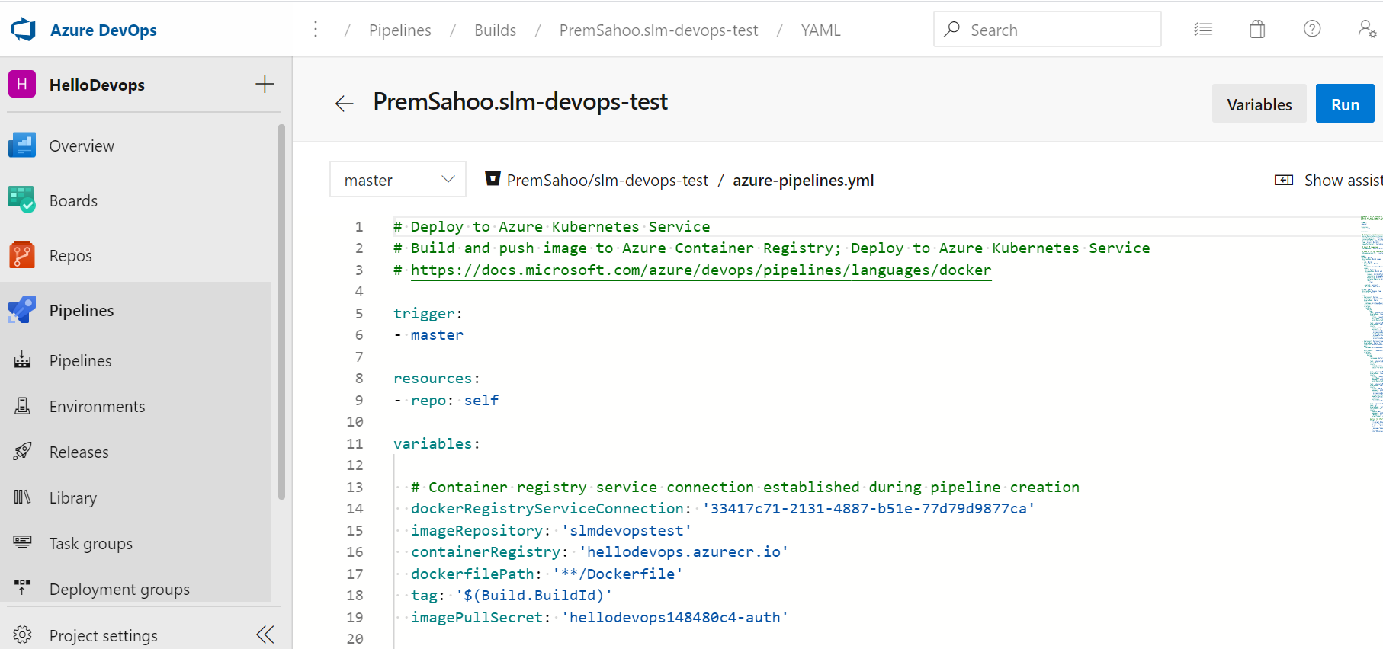
Azure DevOps CI/CD
Once Pipeline is configured, it creates 3 YAML files. ‘azure-pipelines.yml’ in the base directory of the project and ‘deployment.yml’ & ‘service.yml’ 2 files under ‘manifests’ folder in the specific repository.
User can further modify these files according to various project specific changes.

Slide 12
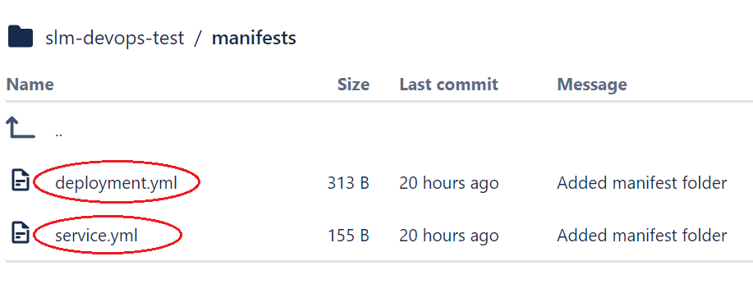
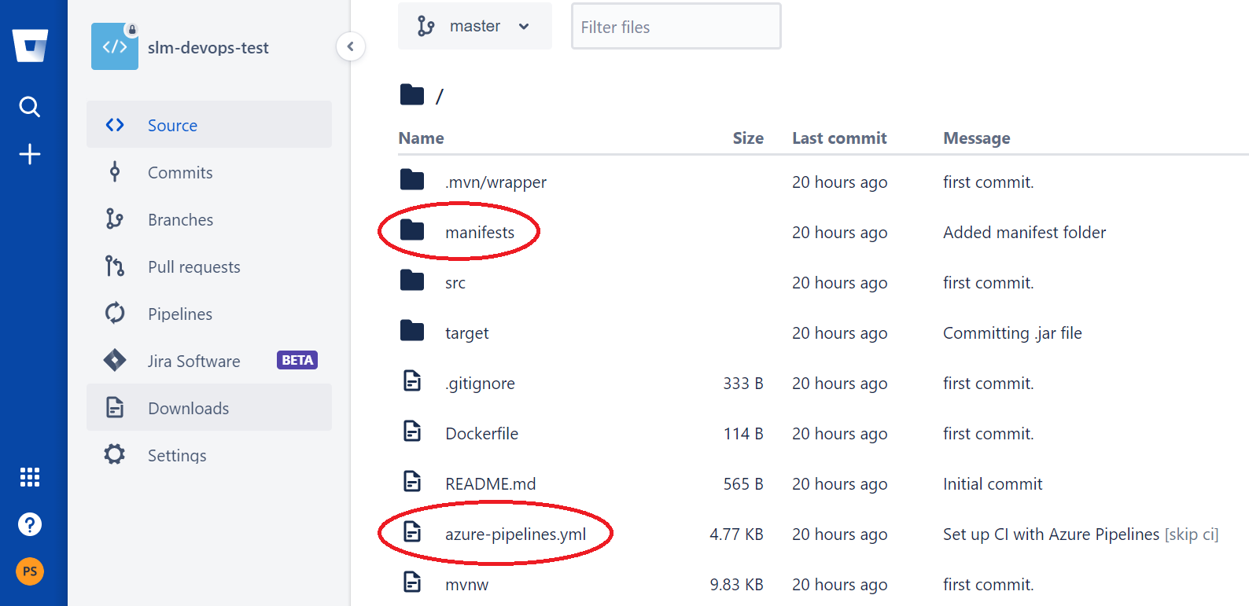
Azure DevOps CI/CD
Once Pipeline is configured, it creates 3 YAML files. ‘azure-pipelines.yml’ in the base directory of the project and ‘deployment.yml’ & ‘service.yml’ 2 files under ‘manifests’ folder in the specific repository.

Slide 13
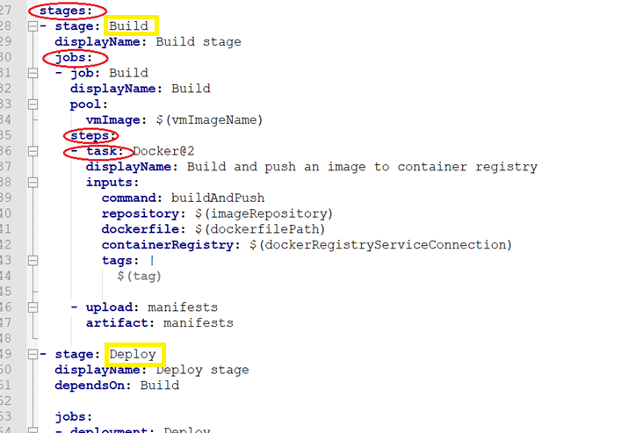
Azure DevOps CI/CD
Pipeline has below hierarchy mentioned in ‘azure-pipelines.yml’ file.

Slide 14
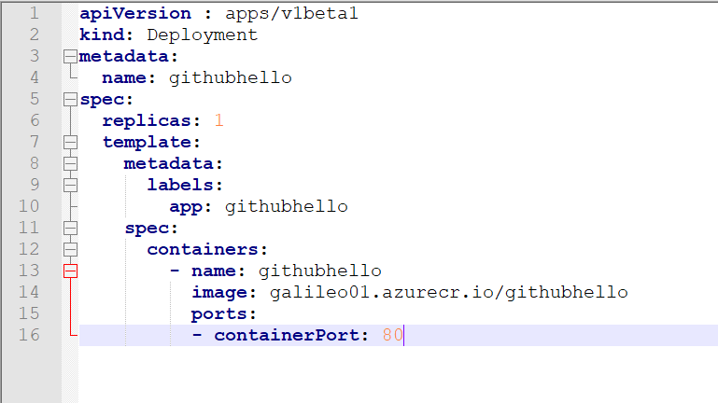
Azure DevOps CI/CD
User can add many parameters related to deployment in AKS in ‘deployment.yml’ file.
‘replicas’ : how many pods(group of docker container image)
Containers: docker container name, image, port, etc.

Slide 15
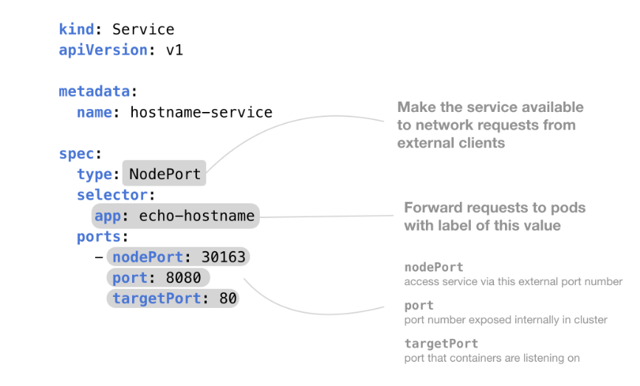
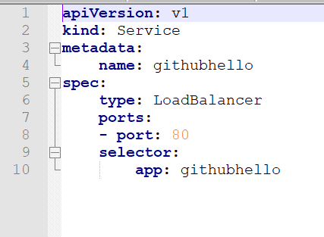
Azure DevOps CI/CD
Networking related configurations goes in ‘service.yml’ file, which allows to access pods from outside of cluster.
Different types of services (ClusterIP, NodePort, and LoadBalancer) can be defined in this file.

Slide 16
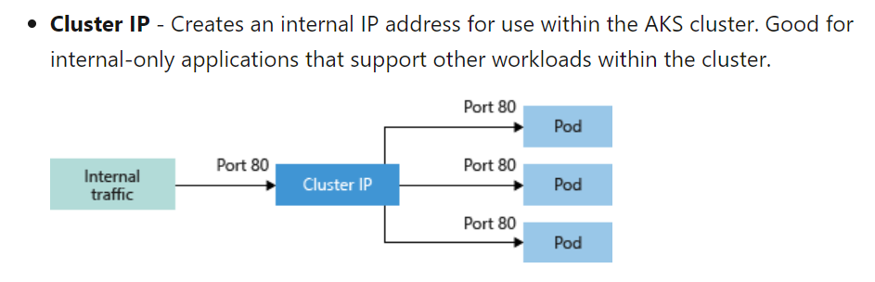
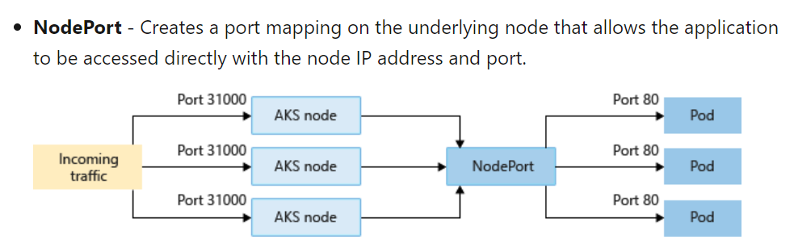
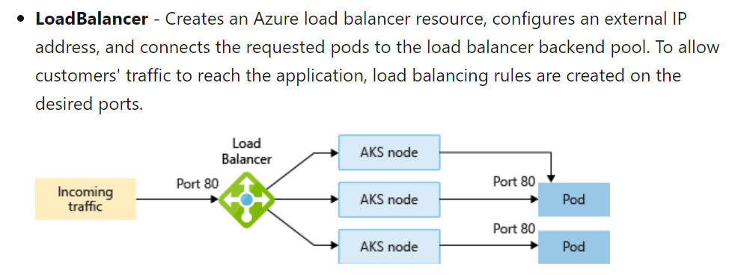
Azure DevOps CI/CD
Different types of services (ClusterIP, NodePort, and LoadBalancer) can be defined in this file.

Slide 17
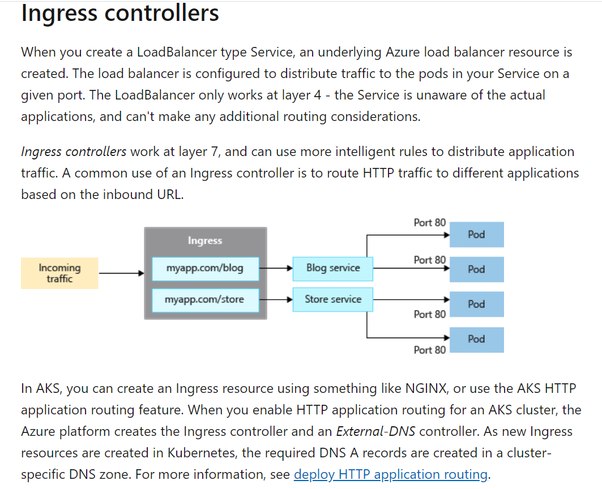
Azure DevOps CI/CD
Load Balancer service created by Azure runs in Layer – 4, so this service does not know much about the actual application. Hence it can not do additional routing.
Ingress Controller works at Layer – 7, so we can map specific URL’s or add more routing rules.

Slide 18
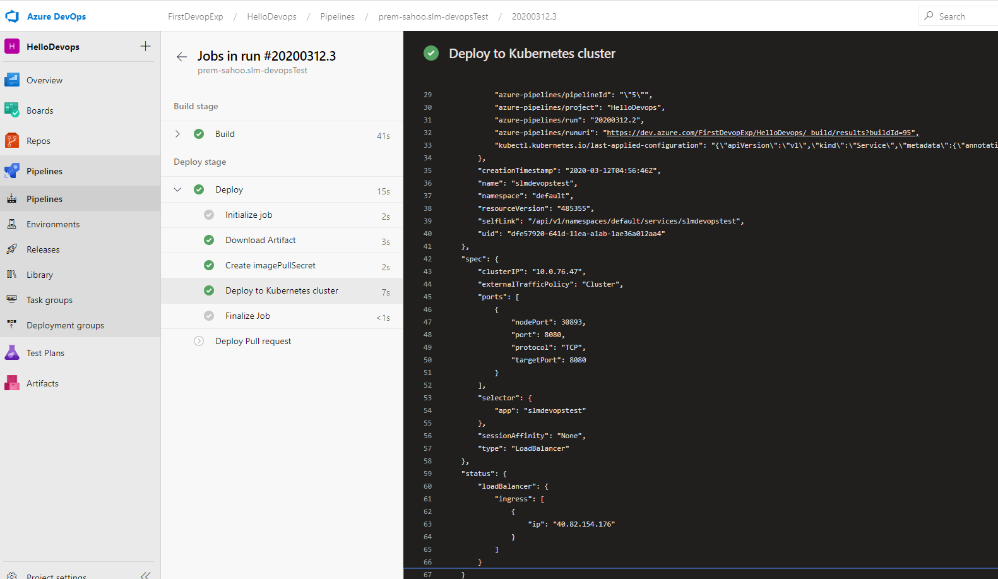
Azure DevOps CI/CD
Pipeline has certain steps, in general ‘Build’ & ‘Deploy’
User can see status and logs in each stage

Slide 19

THANK YOU

